Slide 1
HxGN MineOperate
OP Pro Manager
Client Installation Process
Edgar Sepulveda
Global Technical Manager, MineOperate
Date 10/10/2022
Version 1.3

Slide 2

Purpose
This session
At the end of this module, you will:

Slide 3
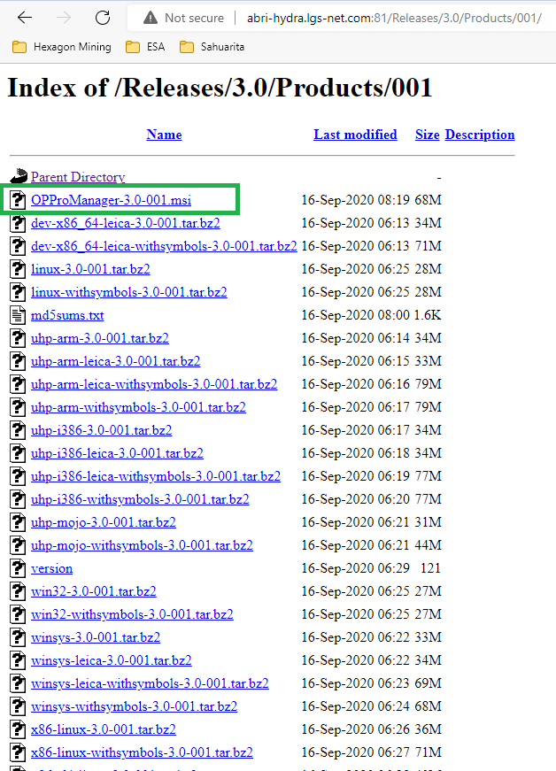
OP Pro Manager Client Installation Process

Slide 4
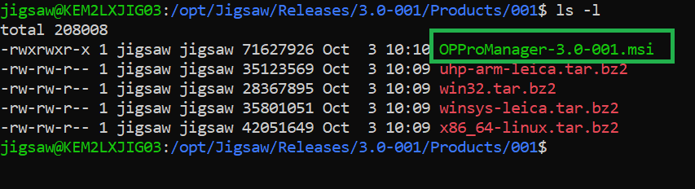
OP Pro Manager Client Installation Process

Slide 5
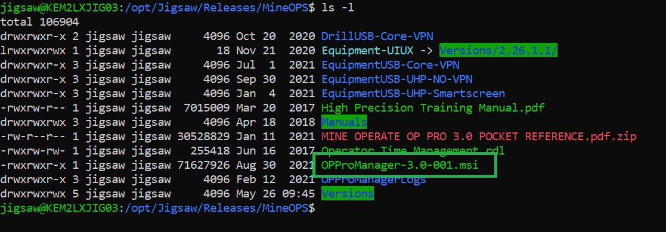
OP Pro Manager Client Installation Process

Slide 6
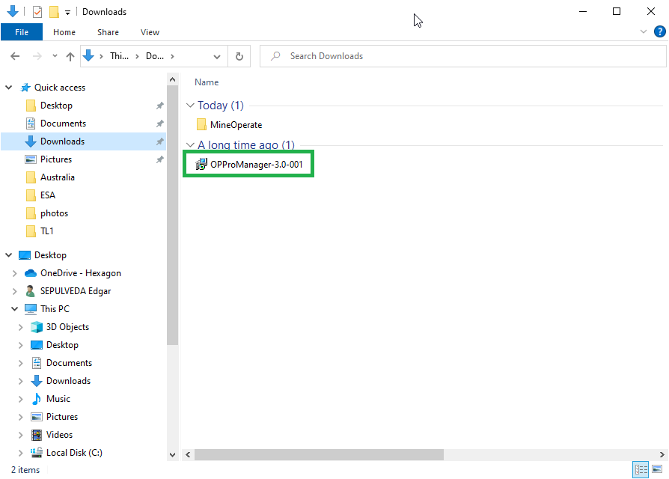
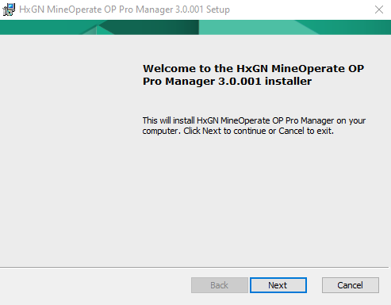
OP Pro Manager Client Installation Process

Slide 7
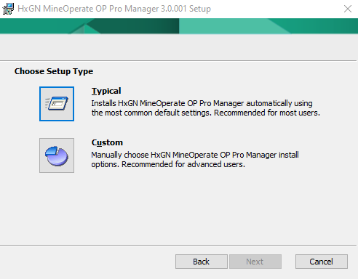
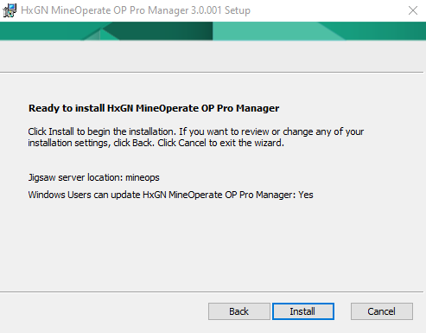
OP Pro Manager Client Installation Process

Slide 8
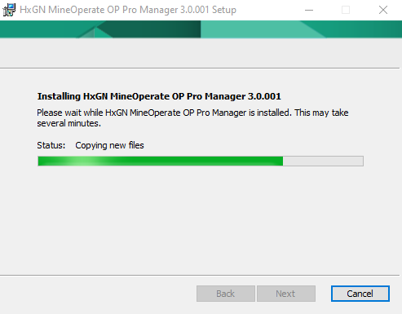
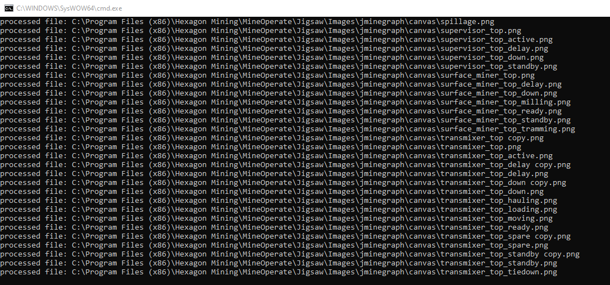
OP Pro Manager Client Installation Process

Slide 9
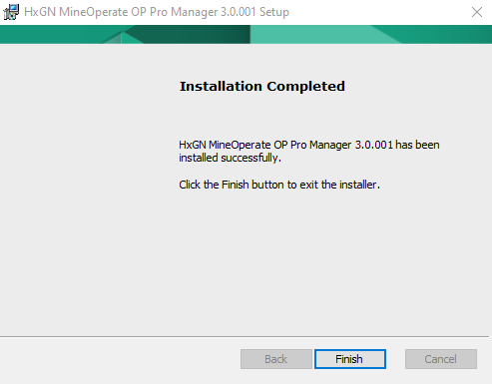
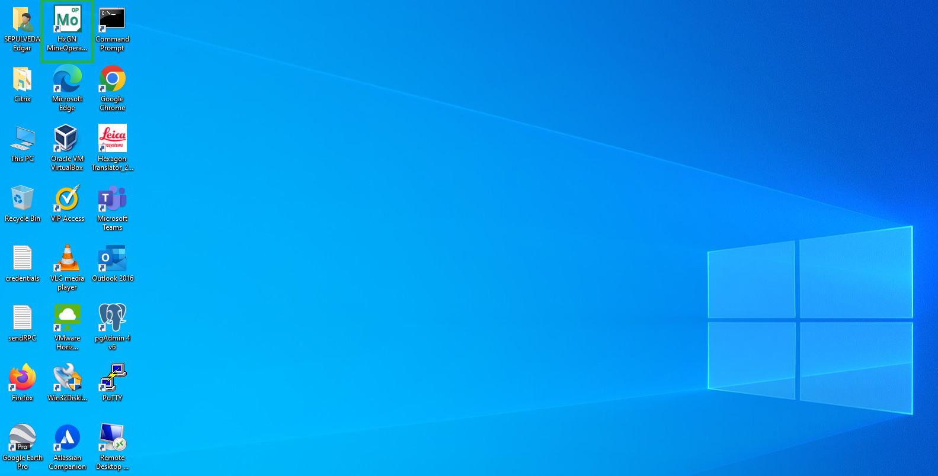
OP Pro Manager Client Installation Process

Slide 10
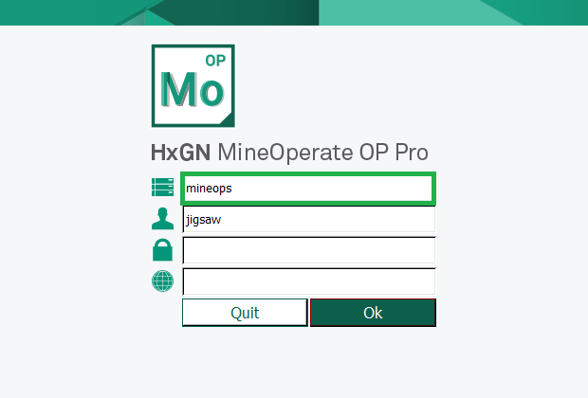
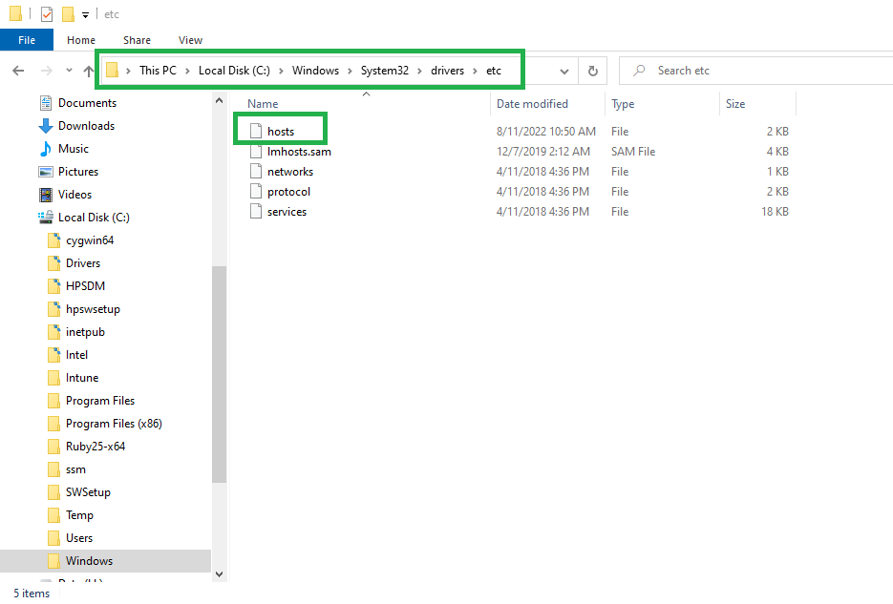
OP Pro Manager Client Installation Process

Slide 11
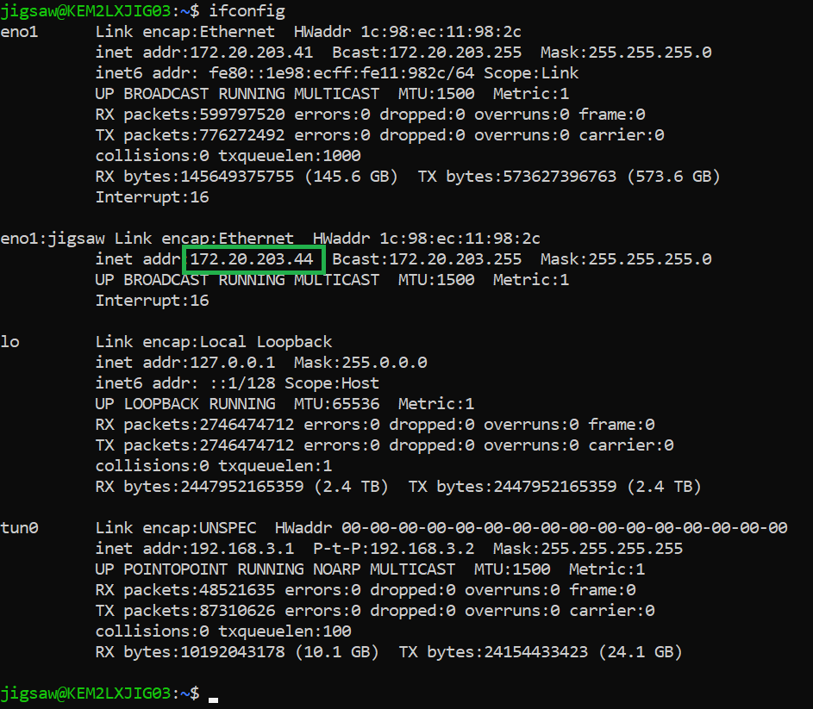
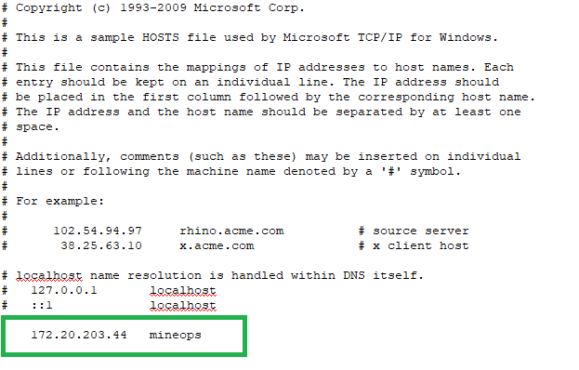
OP Pro Manager Client Installation Process

Slide 12
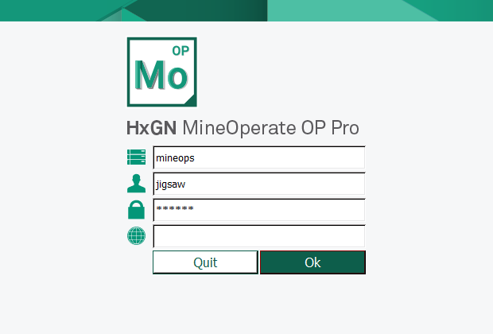
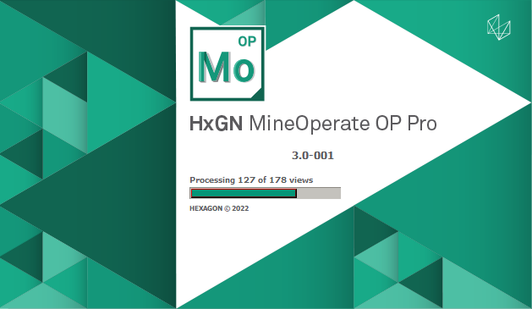
OP Pro Manager Client Installation Process

Slide 13
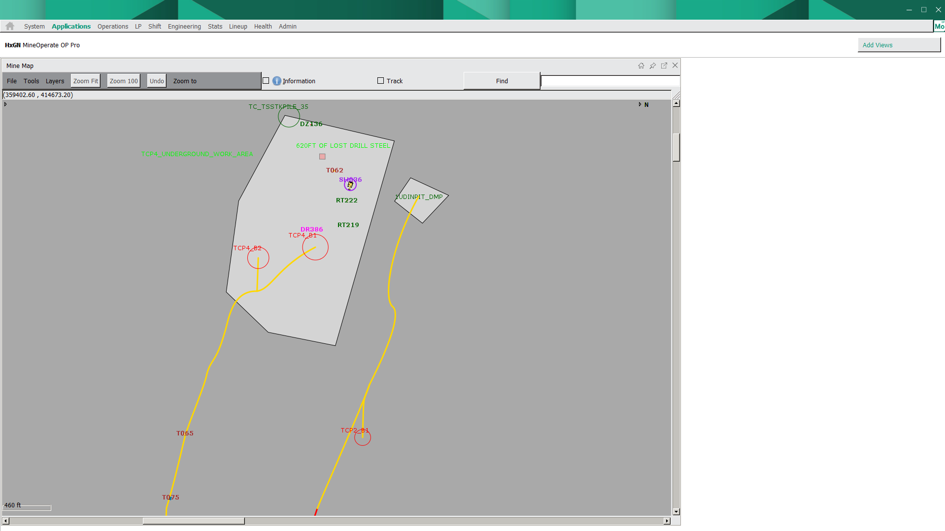
OP Pro Manager Client Installation Process

Slide 14
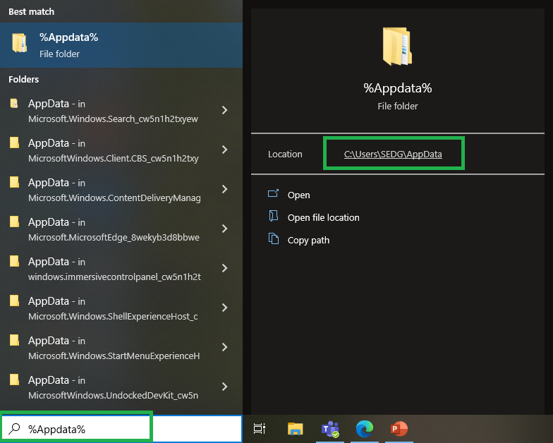
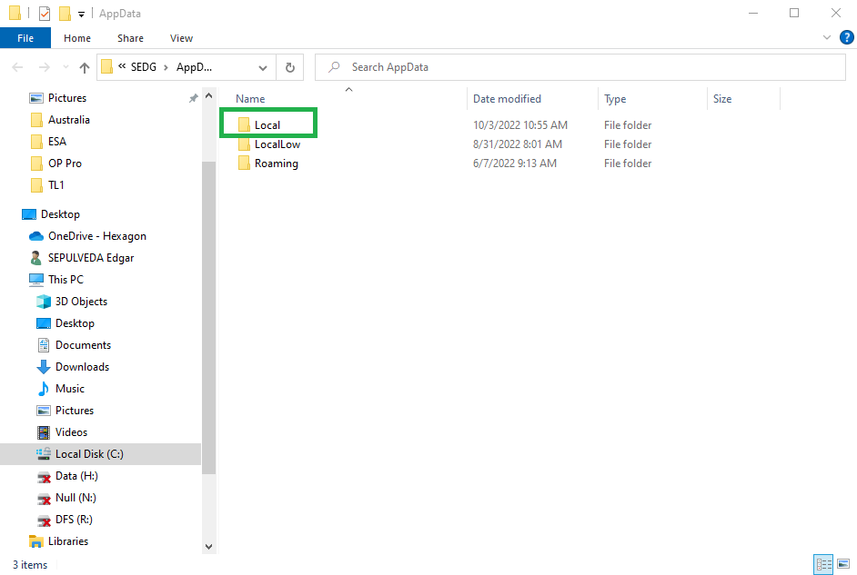
OP Pro Manager Client Installation Process

Slide 15
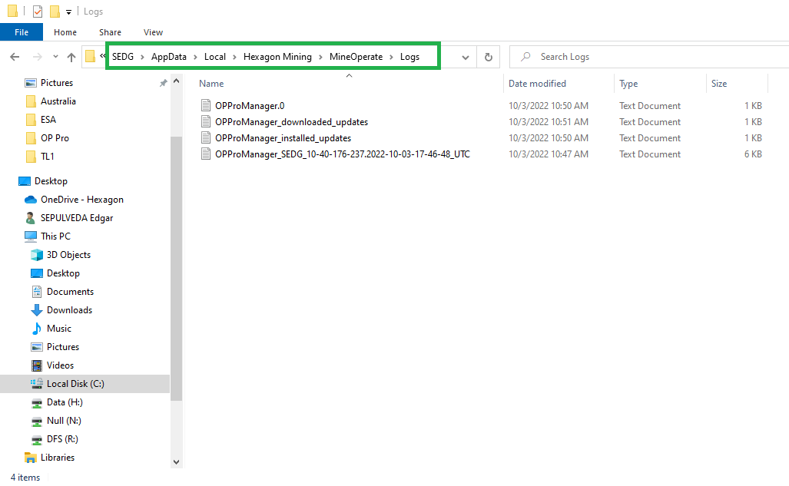
OP Pro Manager Client Installation Process

Slide 16
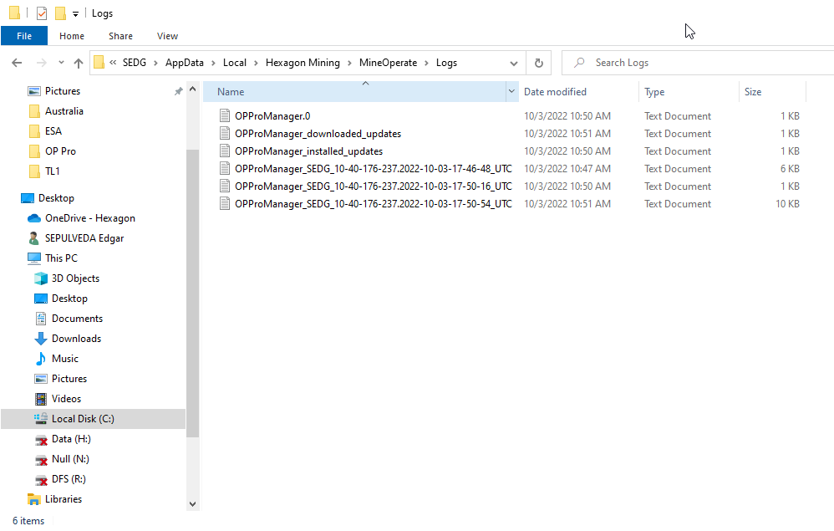
OP Pro Manager Client Installation Process

Slide 17
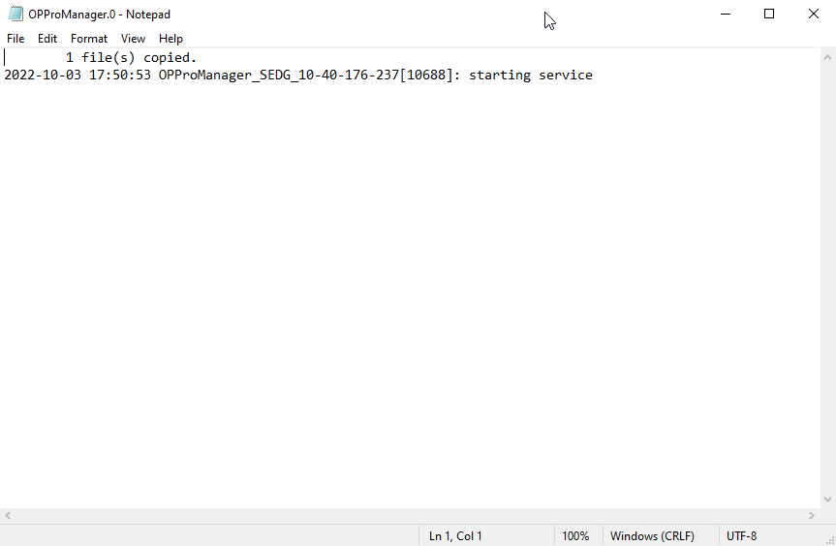
OP Pro Manager Client Installation Process

Slide 18
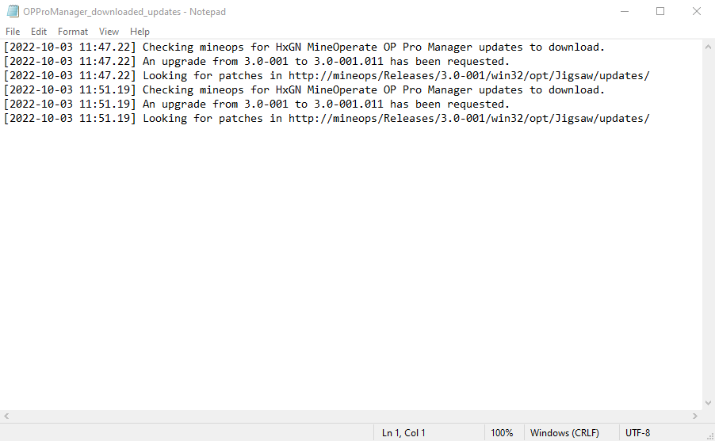
OP Pro Manager Client Installation Process

Slide 19
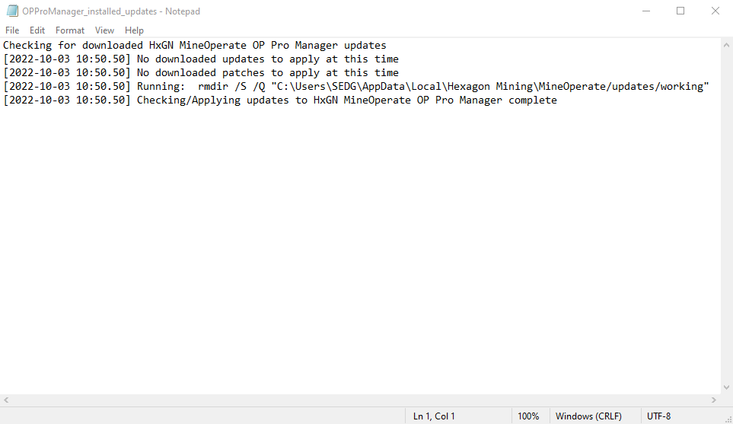
OP Pro Manager Client Installation Process

Slide 20
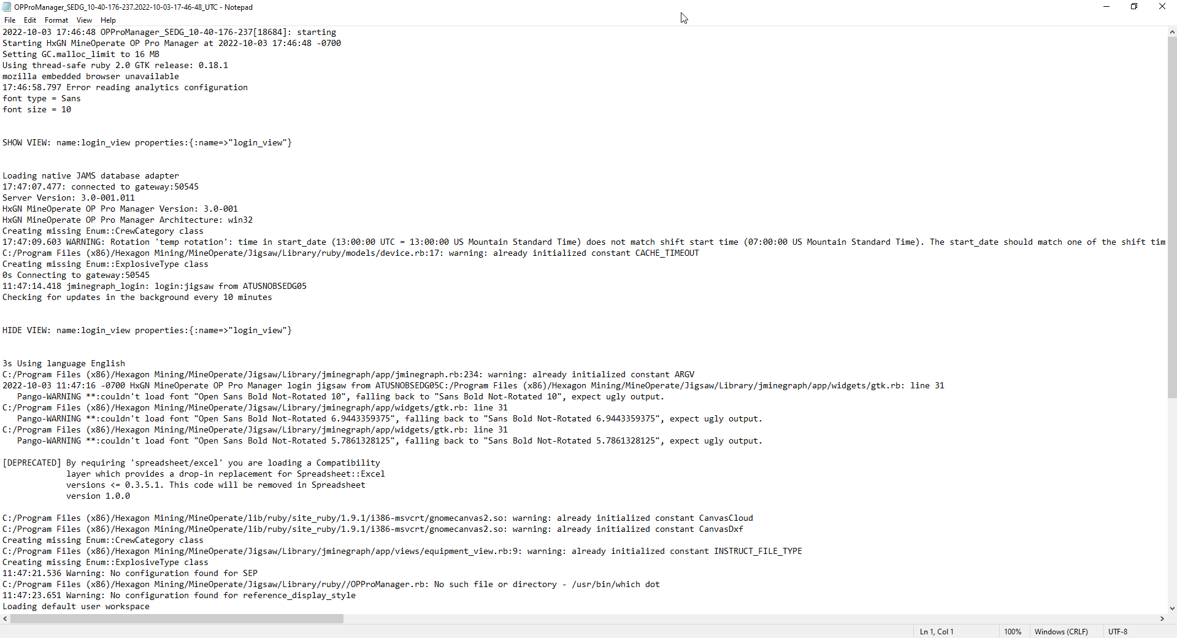
OP Pro Manager Client Installation Process

Slide 21

THANK
Y
O
U

